Slide 1
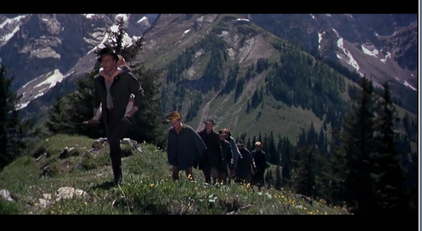
the SOUND of MUSIC
Notes:
By Justina Claggett

Slide 2
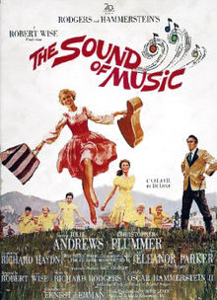
Film Credits
Released in 1965
Film adaptation of the
Broadway show
Crew Credits:
Director: Robert Wise
Screenwriter: Ernest Lehman
Music and Lyrics: Richard Rodgers and Oscar Hammerstein

Slide 3
Awards
Oscars: Won for
Best Director
Best Film Editing
Best Music, Scoring of Music, Adaption or treatment
Best Picture
Best Sound
Golden Globes: Won for
Best Motion Picture: Comedy or Musical
Best Motion Picture Actress: Comedy or Musical
Was nominated for/won numerous other film awards

Slide 4
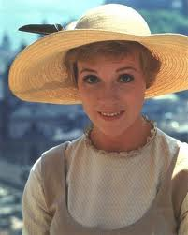
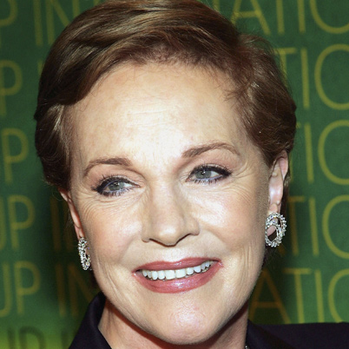
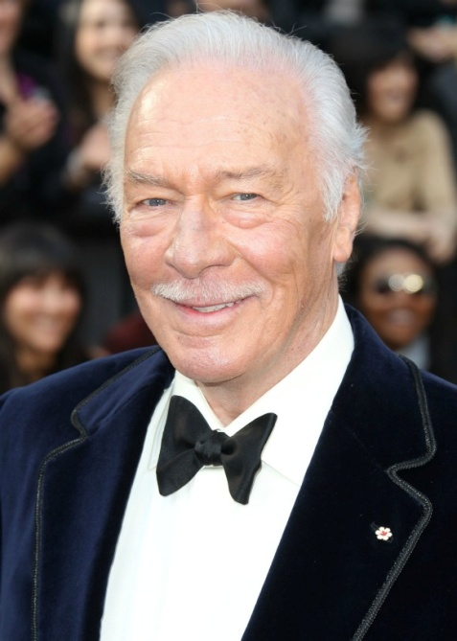
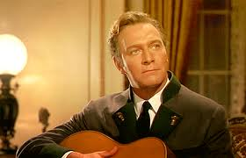
Actors
Maria:
Julie Andrews
Captain Von Trapp: Christopher Plummer

Slide 5
Essential Plot Points
The film is set in Salzburg, Austria in “the last Golden Days of the Thirties,” for the story begins right before the start of WWII. A spirited young woman named Maria is finding it difficult to fit in at the abbey where she is learning to become a nun. Against her wishes, she is sent by the Mother Abbess to become a governess of seven children at the Von Trapp household where the children’s father has become disconnected ever since the death of his wife. As Maria attempts to bring the Von Trapp family together, the world around them is slowly falling apart as WW2 approaches and the Nazis attempt to recruit Captain Von Trapp.

Slide 6
“I Have Confidence”
This scene takes place right after the Mother Abbess has sent Maria away from the abbey. Maria is wondering what her life will be like and if she will succeed in being Governess to seven children. She sings “I Have Confidence” as she travels to the Von Trapp household.
*See flashdrive for clip

Slide 7
THESIS
Through lighting, framing, angles, sound, and mise en scene, the director conveys Maria’s uncertainty as she leaves the safety of the abbey for the challenge of the Von Trapp family and finding her own path in life.

Slide 8
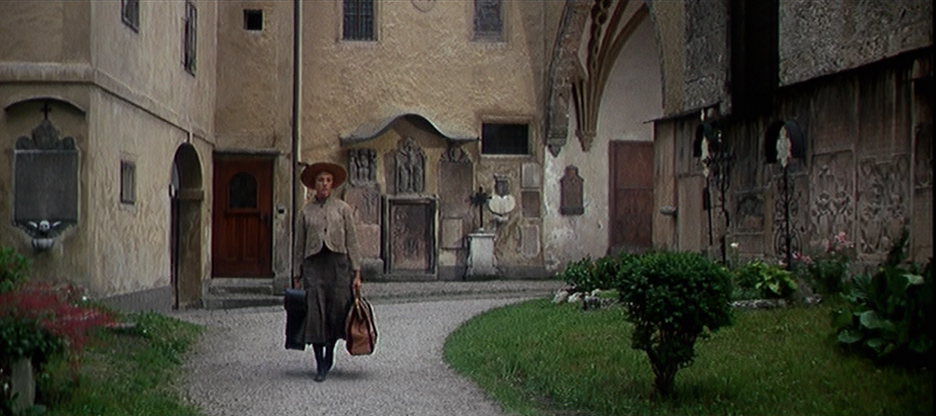
Tilt: from sky to inside the abbey
Diegetic sound: Nuns singing
Long Shot: Maria in the abbey
Meaning: The tilt camera movement to inside the claustrophobic space inside the abbey indicates how small Maria’s world is at the moment and how Maria is not meant to be confined. The nuns singing in the background help to show how all Maria is looking for is her own voice and her own special path in life.

Slide 9
Tilt: from sky to inside the abbey
Diegetic sound: Nuns singing
Long Shot: Maria in the abbey
Teacher note: This student was THOROUGH; you do NOT need so much text/explanation. I recommend more fragmentary ideas/ highlights. Why?
Audience doesn’t want to read a lot
Prevents you as presenter from just reading verbatim from slides
See next slide for revision
Meaning: The tilt camera movement to inside the claustrophobic space inside the abbey indicates how small Maria’s world is at the moment and how Maria is not meant to be confined. The nuns singing in the background help to show how all Maria is looking for is her own voice and her own special path in life.

Slide 10
REVISED to CONDENSE
Tilt: from sky to inside the abbey
small, claustrophobic life
Diegetic sound: Nuns singing
Maria needs to find her OWN voice
Long Shot: Maria in the abbey
start of journey, freedom, finding identity

Slide 11
Low key lighting: Maria in the doorway of the abbey
High key lighting: Maria leaving the abbey
Nondiegetic sound: Maria starts to sing “I Have Confidence”
Meaning: The change from low key lighting to high key lighting as Maria leaves the abbey signifies Maria beginning a new chapter in her life and entering a new world. The shift in sound indicates to the audience that we are in Maria’s head now as she questions her future.

Slide 12
Long shot and High angle: Maria outside the abbey
Medium shot: closest we have seen of Maria so far
Low angle: Maria walking into the town square
Meaning: The long shot of Maria outside the abbey functions to highlight the difference between the abbey and the outside world and high angle is used in this first shot because Maria is doubting herself. The more intimate medium shot is utilized because she is questioning whether or not she will succeed as governess of seven. Maria is now seen with a low angle in this last shot because she is gaining the confidence to face whatever challenges may come to her.

Slide 13
Visual Symbolism: giant horse statue
Medium shot: Maria on the bus
Long shot: Maria about to walk down aisle of trees
Meaning: This horse statue is the first example of the symbol of horses in the film. A horse can symbolize a variety of things including mobility, freedom, strength, and grace which are all recurring thematic ideas in the movie. This second shot gives the film a sense of realism as it is hard to tell what is moving, the bus or the background—either way, it suggests Maria’s journey. This last shot of Maria just foreshadows the long road ahead of her.

Slide 14
FYI:
Other horse imagery!

Slide 15
Mise-en-scene: the Von Trapp family household
Meaning: The first shot of the house can be compared to the image of Maria in the convent; she is moving from a sheltered, comfortable environment to an imposing one.

Slide 16
Eye line match: Maria sees home:
“Oh, help”
overwhelmed
Mise-en-scene and No sound: inside the Von Trapp household:
sterility of the “home”
Maria’s shock, intimidation
Note that this slide has been revised to condense text

